Slide 1
Interpolation 3: Chebyshev Nodes and Cubic Splines
AMSC/CMSC 460
Dr. Christopher Moakler

Slide 2
Review from last lecture
Last time, I went through several examples of calculating interpolating polynomials using the Lagrange method and then Newton’s Divided Difference method.
We also took a look at the Interpolation Error Formula,
$f\left(x\right)−P_{n}\left(x\right)= \frac{\left(x−x_{1}\right)\left(x−x_{2}\right)…\left(x−x_{n}\right)}{(n+1)!}f^{\left(n+1\right)}\left(ξ\right)$.
Using this we are able to put a bound on the error when using an interpolating polynomial.
We then looked at some issues that can arise when using interpolating polynomials.
The main issue we ran into was the “Runge Phenomenon”

Slide 3
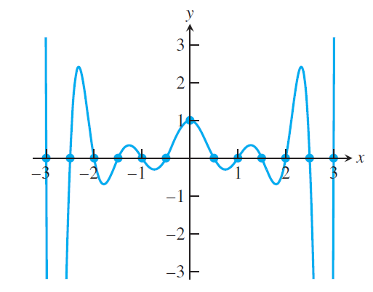
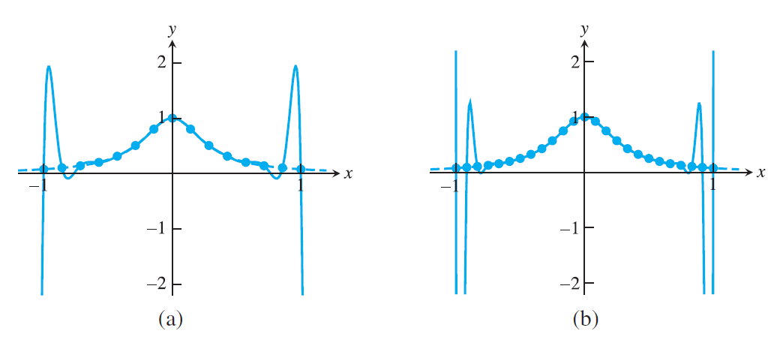
Review from last lecture cont
The Runge Phenomenon describes the tendency of polynomials to “prefer” certain shapes.
These shapes are typically very “wiggly”
This is exacerbated when the points we are trying to interpolate are equally spaced.
Sauer

Slide 4
Review from last lecture cont
The further you get from the center of the interpolating points, the worse the error tends to get and the more “wiggly” the polynomial.
There are two main ways we overcome this problem:
Chebyshev Interpolation
Splines
I’ll discuss these now in turn.

Slide 5
Chebyshev Nodes
We don’t really have much choice when finding an interpolating polynomial.
If we have a set of $n$interpolation points, we can only find a single interpolating polynomial of degree at most $n−1$.
If we can choose our interpolation points, we can choose them to minimize our interpolation error.
Recall,
$$f\left(x\right)−P_{n}\left(x\right)= \frac{\left(x−x_{1}\right)\left(x−x_{2}\right)…\left(x−x_{n}\right)}{(n+1)!}f^{\left(n+1\right)}\left(ξ\right)$$
We can not change the derivative we’re using or the factorial term.
The only thing left to play with is the polynomial portion.

Slide 6
Chebyshev Nodes
More specifically we want to minimize,
$$\max\left(\left|f\left(x\right)−P_{n}\left(x\right)\right|\right)≤\max\left(\left|\frac{\left(x−x_{1}\right)\left(x−x_{2}\right)…\left(x−x_{n}\right)}{\left(n+1\right)!}f^{\left(n+1\right)}\left(ξ\right)\right|\right)$$
$$\max\left(\left|f\left(x\right)−P_{n}\left(x\right)\right|\right)≤\frac{1}{\left(n+1\right)!}\max\left(\left|\left(x−x_{1}\right)\left(x−x_{2}\right)…\left(x−x_{n}\right)\right|\right)\max\left(\left|f^{\left(n+1\right)}\left(ξ\right)\right|\right)$$
Again, we can only play with the polynomial term,
$\max\left(\left|\left(x−x_{1}\right)\left(x−x_{2}\right)…\left(x−x_{n}\right)\right|\right)$.
This is a monic polynomial, that is, the leading coefficient is one.
This polynomial is minimized when the $x_{i}^{′}s$ are the zeros of the Chebyshev Polynomials of the first kind.

Slide 7
Chebyshev Polynomials
There are two types of Chebyshev Polynomials,
Chebyshev Polynomials of the first kind denoted by $T_{n}$
Chebyshev Polynomials of the second kind denoted by $U_{n}$
We are only interested in the first kind.
The Chebyshev Polynomials of the first kind are given by the formula
$$T_{n}\left(\cos\left(θ\right)\right)=\cos\left(nθ\right)$$
Wait. Aren’t these supposed to be polynomials?

Slide 8
Chebyshev Polynomials cont
Let’s look at the Chebyshev Polynomial, $T_{2}$.
$$T_{2}\left(\cos\left(θ\right)\right)=cos\left(2θ\right)=2\cos^{2}{(θ)}−1$$
Let’s make the substitution $x=\cos\left(θ\right)$,
$$T_{2}\left(x\right)=2x^{2}−1$$
You can find the other polynomials similarly.
These are also commonly defined via a recurrence relation:
$T_{0}\left(x\right)=1$
$T_{1}\left(x\right)=x$
$T_{n+1}\left(x\right)=2xT_{n}\left(x\right)−T_{n−1}\left(x\right)$

Slide 9
Chebyshev Polynomials cont
We can derive the $n+1^{th}$ term from the original Chebyshev polynomial as well.
$T_{n+1}\left(x\right)=\cos\left((n+1)θ\right)=cos\left(nθ\right)cos\left(θ\right)−\sin\left(nθ\right)sin⁡(θ)$
$T_{n−1}\left(x\right)=\cos\left((n−1)θ\right)=cos\left(nθ\right)cos\left(θ\right)+\sin\left(nθ\right)sin⁡(θ)$
We can add these together and get,
$$T_{n+1}\left(x\right)+T_{n−1}(x)=2\cos\left(nθ\right)\cos\left(θ\right)$$
$$T_{n+1}\left(x\right)+T_{n−1}(x)=2xT_{n}(x)$$

Slide 10
Chebyshev Polynomials cont
Levy

Slide 11
Chebyshev Polynomials cont
Chebyshev Polynomials have several useful properties.
They are the polynomials with the largest possible coefficient whose magnitude is bounded by 1 on the domain [-1,1].
They also form an orthonormal basis.
This means that any function can be represented as a linear combination of these polynomials.
I am glossing over some major caveats here like the vector space that the functions exist in, the domain, smoothness, etc.

Slide 12
Chebyshev Polynomials useful facts
We will need to make use of some of these facts. Namely,
The Chebyshev polynomials are polynomials.
The degree of $T_{n}$ is $n$ and the leading coefficient is $2^{n−1}$.
$T_{n}\left(1\right)=1$
$T_{n}\left(−1\right)={\left(−1\right)}^{n}$
$\max_{\left|x\right|<1}\left(\left|T_{n}\left(x\right)\right|\right)=1$
$T_{n}\left(x\right)$ has $n$ simple roots at $x_{i}=\cos\left(\frac{π\left(i+\frac{1}{2}\right)}{n}\right)$ with $k=0,1,…,n−1$

Slide 13
Chebyshev’s Theorem
Consider the polynomial,
$$\frac{T_{n}(x)}{2^{n−1}}$$
This is a monic polynomial which can be rewritten as,
$$\frac{T_{n}(x)}{2^{n−1}}=\left(x−x_{1}\right)…\left(x−x_{n}\right)$$
where the $x_{i}$ are the zeros of $T_{n}$.
These $x_{i}$ minimize the value of $\max\left(\left|\left(x−x_{1}\right)\left(x−x_{2}\right)…\left(x−x_{n}\right)\right|\right)$ which was our original goal.
This minimum value is $\frac{1}{2^{n−1}}$.
That is, the value of the maximum error is minimized if we choose the roots of the Chebyshev Polynomial as our interpolation points.
These are often called Chebyshev Nodes.

Slide 14
Chebyshev’s Theorem
The proof of this theorem is done by contradiction.
Assume there is a monic polynomial, $P\left(x\right)$ with a smaller absolute maximum on the interval [-1,1].
The new polynomial, $q\left(x\right)=P\left(x\right)−2^{−n}T_{n+1}(x)$ has $n$ zeros since $T_{n+1}$ alternates between -1 and 1 $n+1$ times.
However, since both $P\left(x\right)$ and $T_{n+1}(x)$ are both monic, their difference is a polynomial of degree at most $n−1$.
A polynomial of degree $n−1$ with $n$ zeros must be the zero polynomial identically.
Thus, $P\left(x\right)=2^{−n}T_{n+1}\left(x\right).$
This contradicts our assumption that $\left|P\left(x\right)\right|<2^{−n}$.

Slide 15
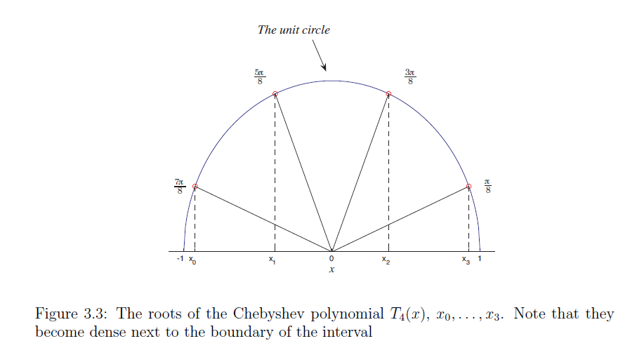
Chebyshev Interpolation
That is to say, if you want to minimize the error in your interpolating polynomial and you are able to, you should choose the zeros of the Chebyshev polynomials as your interpolation points.
$$x_{i}=\cos\left(\frac{π\left(i+\frac{1}{2}\right)}{n}\right)$$
If you do so your interpolation error becomes
$f\left(x\right)−P_{n}\left(x\right)≤\frac{1}{2^{n}\left(n+1\right)!}\max\left(\left|f^{\left(n+1\right)}\left(ξ\right)\right|\right)$.
This only applies for functions on the interval
$−1≤x≤1$.
We can extend this, however.
Levy

Slide 16
Chebyshev Nodes
Sauer

Slide 17
General Chebyshev Interpolation
The preceding discussion applied only to the interval $−1≤x≤1$.
We can extend this to an arbitrary interval $\left[a,b\right]$ by scaling the points by $\frac{b−a}{2}$ and then translating them all by $\frac{b+a}{2}$ to center them properly.
Thus, the Chebyshev Nodes become,
$$x_{i}=\frac{b+a}{2}+\frac{b−a}{2}\cos\left(\frac{\left(2i−1\right)π}{2n}\right)$$
And the monic polynomial is bounded by,
$$\left|\left(x−x_{1}\right)\left(x−x_{2}\right)…\left(x−x_{n}\right)\right|≤\frac{{\left(\frac{b−a}{2}\right)}^{n}}{2^{n−1}}$$

Slide 18
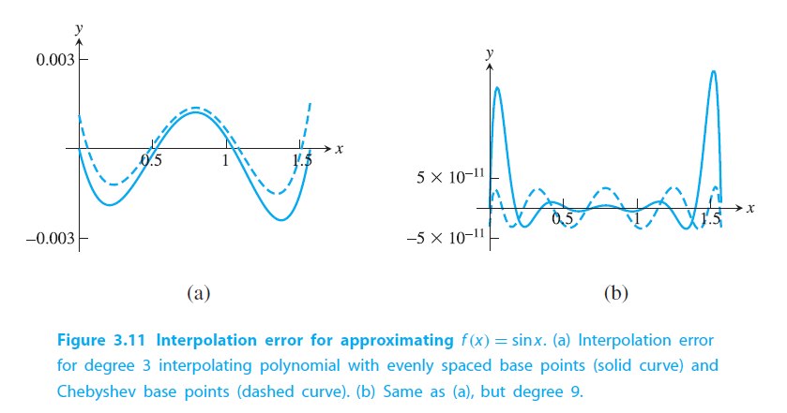
Chebyshev Interpolation Example
Sauer

Slide 19
Spline Interpolation
Spline interpolation avoids the issues of the Runge Phenomenon by decreasing the degree of the interpolating polynomial.
This is done by “splicing” together several lower degree polynomials between the interpolating points.
The simplest spline interpolation is the linear spline.
A linear spline is a fancy term for connecting the dots.
You simply connect straight lines between the data points you wish to interpolate.
This has some pretty obvious pros and cons.

Slide 20
Cubic Spline
The major con we often wish to avoid is the lack of smoothness in a linear spline.
The most common way of addressing this issue is to use a cubic spline.
A cubic spline is a collection of cubic interpolating polynomials that are forced to be smooth when spliced together.
This is done by dictating that the first and second derivatives of adjoining spline components agree.

Slide 21
Cubic Spline Properties
A cubic spline interpolating the data points $\left(x_{1},y_{1}\right),…,(x_{n},y_{n})$ is a collection of cubic polynomials,
$$C_{1}=a_{1}+b_{1}\left(x−x_{1}\right)+c_{1}{\left(x−x_{1}\right)}^{2}+d_{1}{\left(x−x_{1}\right)}^{3}$$
$$C_{2}=a_{2}+b_{1}\left(x−x_{2}\right)+c_{2}{\left(x−x_{2}\right)}^{2}+d_{2}{\left(x−x_{2}\right)}^{3}$$
…
$$C_{n−1}=a_{n−1}+b_{n−1}\left(x−x_{n−1}\right)+c_{n−1}{\left(x−x_{n−1}\right)}^{2}+d_{n−1}{\left(x−x_{n−1}\right)}^{3}$$
Neighboring components are also made to agree in their zeroth, first, and second derivatives.
They also must actually interpolate the points
$C_{i}\left(x_{i}\right)=y_{i}=C_{i−1}\left(x_{i}\right)$ (interpolation and continuity)
$C_{i−1}^{′}\left(x_{i}\right)=C_{i}^{′}\left(x_{i}\right)$ (slope agreement)
$C_{i−1}^{′′}\left(x_{i}\right)=C_{i}^{′′}\left(x_{i}\right)$ (curvature agreement)

Slide 22
Cubic Spline Coefficients
How many unknown coefficients do we have?
Well, each cubic polynomial has 4 coefficients.
There are $n−1$ polynomials.
We therefore have $4(n−1)$ coefficients.
How many equations do we have?
There are $2(n−1)$ from the interpolation and continuity requirements.
There are then $2(n−2)$ from the first and second derivative requirements.
We have 2 degrees of freedom left over!

Slide 23
Natural Cubic Spline Interpolation
We can address this deficiency by adding some conditions to the spline.
This is typically done by adding “end conditions”.
The most common end condition is to make the second derivative at the end points equal to 0.
That is,
$C_{1}^{′′}\left(x_{1}\right)=0$ and $C_{n−1}^{′′}\left(x_{n}\right)=0$.
I have seen several explanations as to why this is the “natural” cubic spline.
I’m pretty sure it’s because this is what happens when you have actual real-world splines.

Slide 24
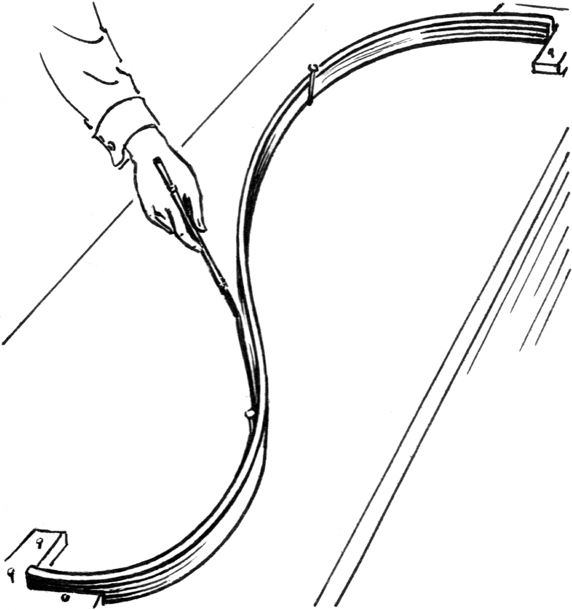
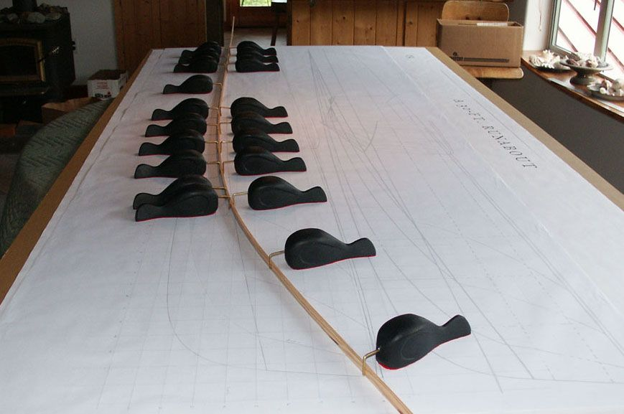
Real World Splines
https://www.core77.com/posts/55368/When-Splines-Were-Physical-Objects
https://en.wikipedia.org/wiki/Flat_spline#/media/File:Spline_(PSF).png

Slide 25
Cubic Spline system of equations
To actually solve the system of equations, we need to introduce some notation.
Let $h_{i}=x_{i+1}−x_{i}$ and $z_{i}=C_{i}^{′′}(x_{i})$
The second derivative of $C_{i}$ is linear and connects the points $\left(x_{i},z_{i}\right)$ and $\left(x_{i+1},z_{i+1}\right).$
Thus, we can write,
$$C_{i}^{′′}\left(x\right)=\frac{x−x_{i}}{h_{i}}z_{i+1}−\frac{x−x_{i+1}}{h_{i}}z_{i}$$
Integrate once to get,
$$C_{i}^{′}\left(x\right)=\frac{1}{2}{\left(x−x_{i}\right)}^{2}\frac{z_{i+1}}{h_{i}}−\frac{1}{2}{\left(x−x_{i+1}\right)}^{2}\frac{z_{i}}{h_{i}}+\tilde{c}$$

Slide 26
Cubic Spline system of equations
Integrate again to get,
$$C_{i}\left(x\right)=\frac{z_{i+1}}{{6h}_{i}}{\left(x−x_{i}\right)}^{3}−{\frac{z_{i}}{6h_{i}}\left(x−x_{i+1}\right)}^{3}+Cx+D$$
The interpolation and continuity condition gives us,
$$C_{i}\left(x\right)=\frac{z_{i+1}}{{6h}_{i}}{\left(x−x_{i}\right)}^{3}−{\frac{z_{i}}{6h_{i}}\left(x−x_{i+1}\right)}^{3}+\left(\frac{y_{i+1}}{h_{i}}−\frac{z_{i+1}}{6}h_{i}\right)(x−x_{i})+\left(\frac{y_{i}}{h_{i}}−\frac{z_{i}}{6}h_{i}\right)(x_{i+1}−x)$$
Imposing the first and second derivative conditions yields a system of equations that is pretty ugly.
Levy

Slide 27
Cubic Spline system of equations cont
The coefficient matrix is symmetric, tridiagonal, and diagonally dominant so finding the inverse is straightforward.
If the interpolating points are equally spaced, i.e. $h_{i}=h$, then the system is further simplified to,
Levy

